Slide 1
Chapter 2
The Constitution
American Democracy Now, 7th edition
Brigid Callahan Harrison
Jean Wahl Harris
Michelle D. Deardorff
Copyright 2022 © McGraw Hill LLC. All rights reserved. No reproduction or distribution without the prior written consent of McGraw Hill LLC.

Slide 2
What Is a Constitution? 1
Constitution: the fundamental principles of a government and the basic structures and procedures by which the government operates to fulfill those principles.
Typically a constitution will begin with a statement of the government’s mission.
Long-term goals as envisaged by its founders—for example, the Preamble to the U.S. Constitution.

Slide 3
What Is a Constitution? 2
Description of the governmental structure.
U.S. Constitution describes three foundational government bodies—the legislative, executive, and judicial branches—and describes the responsibilities of each body as well as the relationships among these bodies.
Description of essential operating procedures.
Including those used to select national government officials, to make laws, and to amend and ratify the constitution.

Slide 4
The Creation of the United States of America 1
In the 1600s, waves of Europeans colonized North America.
Diversity of people and a mix of economic classes migrated to the colonies, including indentured servants and slaves.
Two-tier system of governance evolved.
Colonists were excluded from participation in the political processes of British government.

Slide 5
The Creation of the United States of America 2
Over the course of the 18th century, a sense of grievance developed, especially as parliamentary legislation placed more and more restrictions on the colonists’ freedoms.
Colonists expressed support for the principles of government by the people (popular sovereignty) and for the people (government established to protect the people’s liberties).

Slide 6
British Policies Incite Revolution in the Colonies
Taxation without representation led to boycotts and protests.
Costs of French and Indian War (1756 to 1763).
British Parliament turned to the colonies for increased revenues:
Sugar Act (1764).
Stamp Act (1765).
Quartering Act (1765 and 1766).
Declaratory Act (1766).
Townshend Act (1767).

Slide 7
A “Massacre,” a Monopoly, and a Tea Party
“Boston Massacre,” March 5, 1770.
In 1772, Samuel Adams and the Massachusetts Committee of Correspondence spread calls for rebellion.
Tea Act (1773).
Boston Tea Party, December 16, 1773.
Parliament responded with the Coercive Acts (Intolerable Acts), which closed the port of Boston.
Martial law, suspension of colonial assemblies, and a ban on town meetings.

Slide 8
The First Continental Congress: A Declaration of Rights and Grievances
First Continental Congress, September 1774.
Congress adopted and sent to the king the Declaration of Rights and Grievances.
Congress also adopted the Articles of Association—a plan to create a parliament for the colonies.
April 19, 1775, shots fired at Lexington and Concord.
Second Continental Congress was convened, May 10, 1775.
Empowered Congress to function as an independent government and to prepare for war with Britain.

Slide 9
The Common Sense of Declaring Independence
Thomas Paine and Common Sense, January 1776.
Declaration of Independence, July 4, 1776.
Thomas Jefferson was chosen to draft the declaration.
Three ground-breaking principles:
All men are equal and have natural rights (also called unalienable rights).
Government must be based on consent of the governed.
If a government is not protecting the rights of the people, the people have the duty to abolish it and create a new government.
Declaration proved a rallying point for independence.

Slide 10
The State Constitutions
By the end of 1776, eight of the 13 colonies had ratified state constitutions.
New state constitutions were revolutionary.
Each a single, written document.
Adopted at a specific moment of time versus cumulative.
People were not regarded as “subjects” but as citizens.
Each established a sovereign republic.
Bicameral legislatures were the norm.
Each government’s mission: to ensure natural rights.

Slide 11
The Articles of Confederation (1781 to 1788)
People and their delegates to the Second Continental Congress distrusted a strong, distant central government.
Nevertheless recognized a need for a unified authority to engage in international trade, foreign affairs, and defense.
Articles of Confederation established a confederation: a union of independent states in which each state retains its sovereignty, rights, and power.

Slide 12
Structure and Authority of the Confederation
Articles of Confederation created only one governing body, a unicameral legislature (single chamber).
Each state had multiple delegates, but only one vote.
Approving policies and ratifying treaties required nine affirmative votes.
There was no judicial branch, executive branch, or chief executive officer.
Congress could not raise revenue through taxation.
Amendments to the Articles of Confederation required approval of all 13 states.

Slide 13
Table 2.2 Creation of the U.S. Confederation
YEAR | EVENT OR ACTION
1774 | First Continental Congress held
1775 | Second Continental Congress held
1776 | Eight state constitutions ratified
1776 | Declaration of Independence signed
1777 | Articles sent to states
1781 | Articles ratified by states and go into effect
1783 | War for Independence ends with signing of Peace Treaty
Table divided into two columns summarizes creation of the United States Confederation. Column 1 notes year. Column 2 notes a list of creation.

Slide 14
Weaknesses of the Confederation
States retained ultimate authority over day-to-day life, commerce, and currency.
States taxed goods from other countries and other states.
States issued their own money.
Policies caused economic hardship.
Shays’s Rebellion in 1786 highlighted the weaknesses of the national confederacy and the need for a stronger central government.

Slide 15
Calls to Remedy Defects of the Articles of Confederation
Congress was unable to pay the costs of governing.
Violent rebellions threatened peace and security.
Delegates from five states met in Annapolis to try to “remedy defects of the Federal Government.”
Principle issue was problematic trade and commerce.
Other problems were hinted at.
Called for representatives from all states to attend the next meeting.

Slide 16
Crafting the Constitution of the United States
Convention to address defects in the Articles of Confederation was held in Philadelphia from May 25 through September 17, 1787.
All states except Rhode Island sent delegates.
Most delegates were American elites—lawyers, businessmen, or plantation owners.
Delegates had to balance their preference for a strong central government with citizens’ distrust of it.
Conflict also occurred over slavery.

Slide 17
Areas of Consensus 1
Creation of a federal system with dual sovereignty.
Sovereignty shared between a central government and regional governments.
Constitutional supremacy.
Clause in Article VI of the Constitution states that the Constitution and the treaties and laws created by the national government in compliance with the Constitution are the supreme law of the land.
Commonly known simply as the supremacy clause.

Slide 18
Areas of Consensus 2
Separation of powers with integrated checks and balances.
Framers separated the primary governing functions among the three branches of government so that no one group of governing officials controlled all governing functions (separation of powers).
Framers also established various mechanisms by which each branch can monitor and limit functions of other branches to ensure no branch acts to the detriment of citizens’ natural rights (checks and balances).

Slide 19
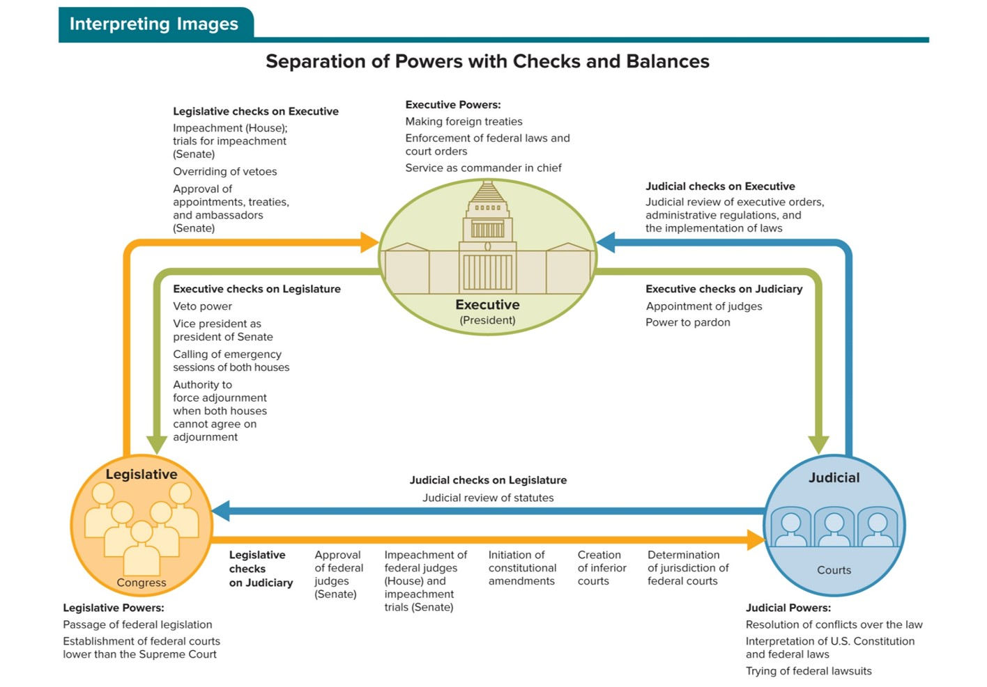
Figure 2.1 Separation of Powers with Checks and Balances
Access the text alternative to slide image

Slide 20
Conflict and Compromise over Representation 1
Two plans were proposed: the Virginia Plan (favored by large states) and the New Jersey Plan (favored by small states).
Connecticut Compromise (or Great Compromise) created today’s bicameral Congress.
State representatives in the House of Representatives would be based on each state’s population.
Equal state representation in Senate (two senators per state).

Slide 21
Conflict and Compromise over Representation 2
Constitution placed limits on representative democracy.
Electoral College and the Twelfth Amendment (1804).
Election of senators by state legislatures, until ratification of the Seventeenth Amendment (1913).
Framers effectively limited the right to vote.
States were given the authority to determine the right to vote.
Women and many men, including Native Americans and slaves, were excluded.

Slide 22
Conflict and Compromise over Slavery
Article I, section 9, of the Constitution postponed the slave debate until 1808.
Importation of newly enslaved people could continue.
Article IV established states’ obligation to deliver all fugitive slaves back to their owners.
Three-Fifths Compromise counted each slave as three-fifths of a free man for the purpose of representation and taxes.
Ultimately the document the framers sent to the states for ratification aimed to fulfill the principles of the Declaration of Independence—for a select group of people.

Slide 23
What About a Bill of Rights?
New Constitution as drafted had no bill of rights.
Virginia delegate George Mason called for a bill of rights like those found in the state constitutions.
Connecticut delegate Roger Sherman argued rights were already protected by the state constitutions.
Lack of a bill of rights became a target for criticism of the proposed constitution.

Slide 24
Congress Sends the Constitution to the States for Ratification 1
Article I: the legislative branch.
Article II: the executive branch.
Veto: the president’s rejection of a bill.
Advice and consent: the Senate’s authority to approve or reject the president’s top appointments and treaties.
Article III: the judicial branch.
Marbury v. Madison: the 1803 Supreme Court case that established the power of judicial review.

Slide 25
Congress Sends the Constitution to the States for Ratification 2
Article IV: state-to-state relations.
Article V: the amendment process.
Article VI: supremacy of the Constitution.
Article VII: the constitutional ratification process.
Ratification of the Constitution required the affirmative vote of special conventions in 9 of the 13 original states.

Slide 26
The Ratification Debate: Federalists versus Anti-Federalists
Federalists supported the Constitution as presented by the convention delegates.
Anti-Federalists opposed the Constitution on the grounds that it gave the national government too much power—power that would erode states’ authority and endanger individual freedoms.

Slide 27
The Anti-Federalists’ Concerns with the Proposed Constitution
Anti-Federalists were concerned that the Constitution ceded too much power to the national government, at the expense of both the states and the people.
Argued a bill of rights was essential to preserving individual liberties.
Thomas Jefferson and Mercy Otis Warren were prominent Anti-Federalists.
Mercy Otis Warren wrote several pieces critical of the proposed constitution under the pen name “A Columbian Patriot.”

Slide 28
The Federalist Papers: In Support of the Constitution
Federalists made their most famous arguments in a series of essays: The Federalist Papers.
Authors James Madison, Alexander Hamilton, and John Jay knew achieving ratification depended on convincing the public and state legislators that the Constitution would empower the new nation to succeed.
Different essays addressed different aspects of the ratification debate.

Slide 29
Ratification: Constitution (1788) and Bill of Rights (1791)
With the proviso that a bill of rights would be the first order of business for Congress, the last four states of the nine needed ratified the Constitution in 1788.
Bill of Rights amendments were ratified in 1791.
First eight amendments establish the government’s legal obligation to protect several specific liberties (known as civil liberties).
Ninth Amendment indicates this list of liberties is not exhaustive.
Tenth Amendment preserves the states’ rights.

Slide 30
Table 2.3 Creation of the U.S. Federal System
DATE | EVENT OR ACTION
May 25–September 17, 1787 | Constitutional Convention occurs
June 21, 1788 | Constitution replaces Articles
February 4, 1789 | First presidential election takes place
March 4, 1789 | First Congress under Constitution convenes
April 6, 1789 | Results of presidential election announced
June 8, 1789 | James Madison proposes 12 amendments
September 25, 1789 | Congress approves 12 proposed amendments
February 2, 1790 | Supreme Court convenes for first time
December 15, 1791 | Virginia is ninth state to ratify 10 of 12 amendments; Bill of Rights is ratified
Table divided into two columns summarizes creation of the United States federal system. Column 1 notes a list of years. Column 2 notes a list of events.

Slide 31
The Constitution as a Living, Evolving Document
As a result of the give-and-take necessary to achieve ratification, the Constitution is replete with vague and ambiguous language.
Framers expected it would be reviewed and revised through both formal amendment and judicial interpretation.
Constitution therefore derives from a continuing conversation about the core beliefs and principles of not just the framers but also the generations that have followed.

Slide 32
Formal Amendment of the Constitution
Every term, members of Congress introduce 100 to 200 proposals for new constitutional amendments.
Only 33 proposals have achieved the two-thirds necessary in Congress; and 27 proposals have been ratified by the states.
Three categories of amendments have been ratified.
Extensions of civil liberties and civil rights.
Alteration of the selection of officials or the operation of the branches of the national government.
Important policy issues.

Slide 33
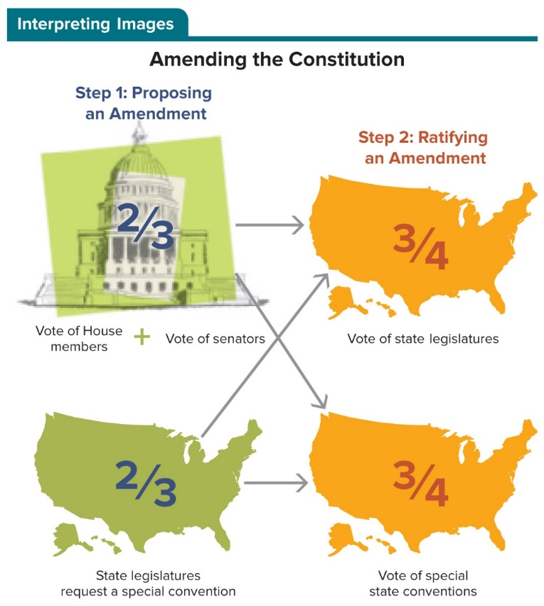
Figure 2.2 Amending the Constitution
There are two methods of proposing an amendment: by a two-thirds majority vote in each chamber, after which it is sent to the states; or through a special convention requested by two-thirds of the state legislatures. There are two avenues for ratifying an amendment: by approval of three-quarters of either the states’ legislatures or the special state conventions.

Slide 34
Interpretation by the U.S. Supreme Court
Marbury v. Madison (1803) established the principle of judicial review—the authority off the courts to rule on whether acts of government officials and governing bodies violate the Constitution.
Three recurring themes in Supreme Court rulings:
Nature of the Constitution as a document that continues to evolve as the courts interpret changing social norms.
Tensions created by the foundational structures established in the Constitution.
Clarification of the rights guaranteed by the Bill of Rights.

Slide 35
Review 1
Then—To establish a representative democracy that protects individual liberties, the Constitution’s framers divided governmental power between the federal and the state governments and created checks and balances among the three separate branches of the national government.
Now—Questions about the meaning of constitutionally established governing structures and procedures, rights, and liberties regularly end up at the doorstep of the U.S. Supreme Court as the nation continues to pursue a more perfect union.

Slide 36
Review 2
Next:
Will the courts’ constitutional interpretations alter the balance of power between national and state governments?
Will the courts’ interpretations of constitutional separation of powers and checks and balances change the balance of power among the three separate branches of the national government?
How will the Constitution affect your pursuit of happiness?

Slide 37
Questions?

Slide 38
End of Main Content
Copyright 2022 © McGraw Hill LLC. All rights reserved. No reproduction or distribution without the prior written consent of McGraw Hill LLC.

Slide 39
Accessibility Content: Text Alternatives for Images

Slide 40
Figure 2.1 Separation of Powers with Checks and Balances - Text Alternative
Return to parent-slide containing images.
Executive powers: making foreign treaties; enforcement of federal laws and court orders; service as commander in chief.
Legislative powers: passage of federal legislation; establishment of federal courts lower than the Supreme Court.
Judicial powers: resolution of conflicts over the law; interpretation of U.S. Constitution and federal laws; trying of federal lawsuits.
Executive checks on Legislature: veto power; vice president as president of Senate; calling of emergency sessions of both houses; authority to force adjournment when both houses cannot agree on adjournment.
Executive checks on Judiciary: appointment of judges; power to pardon.
Legislative checks on Executive: impeachment (House); trials for impeachment (Senate); overriding of vetoes; approval of appointments, treaties, and ambassadors (Senate).
Legislative checks on Judiciary: approval of federal judges (Senate); impeachment of federal judges (House) and impeachment trials (Senate); initiation of constitutional amendments; creation of inferior courts; determination of jurisdiction of federal courts.
Judicial checks on Executive: judicial review of executive orders; administrative regulations; and the implementation of laws.
Judicial checks on Legislature: judicial review of statutes.
Return to parent-slide containing images.

